Slide 1
Cape Cod Supplemental 2012 Plan

Slide 2
Overview
Due to limited OOH options on Cape Cod, supplemental media budgets are allocated for every month OOH is planned throughout the co-op
  Budget is based on what it would cost to implement similar media
Budget
  $46,200 ($11,550 per month)
Timing
  6/4 – 8/5 to align with co-op out-of-home showing and busy summer season
Media plan
  Direct mail
    June 25
  Radio:
    May 31 – August 5
  OOH
    June 25 – August 5

Slide 3
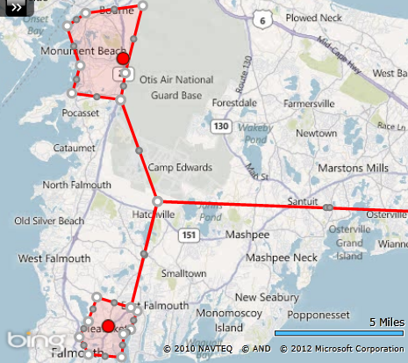
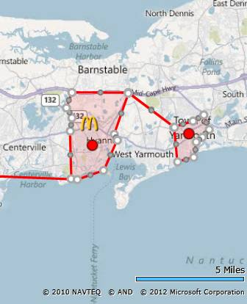
Direct Mail
Use Ready Aim Mail to target households and businesses surrounding Cape stores to drive traffic
Timing: On/around 6/25
Cost: $8,284
Household quantity: 12,000
Business quantity: 4,370
Coupon drop footprint based on custom geographies
Coupon will feature ice blended beverages

Slide 4
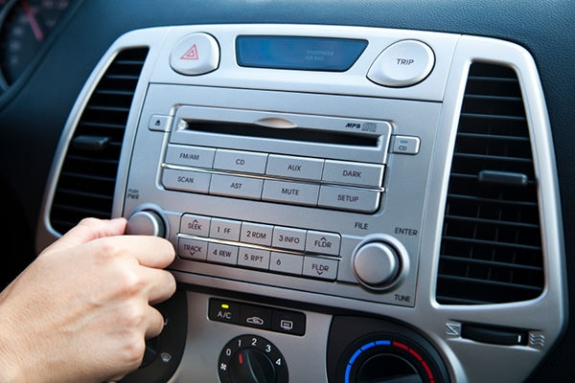
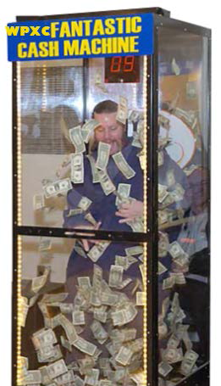
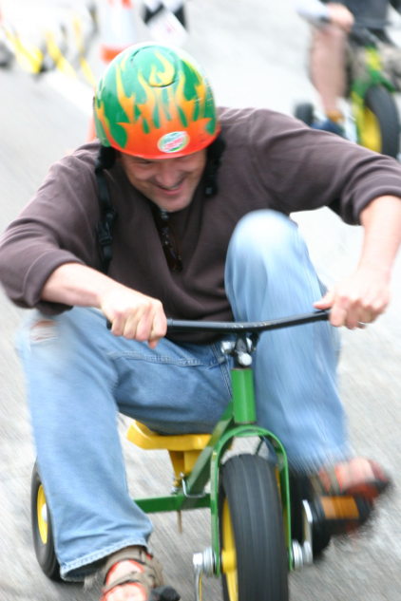
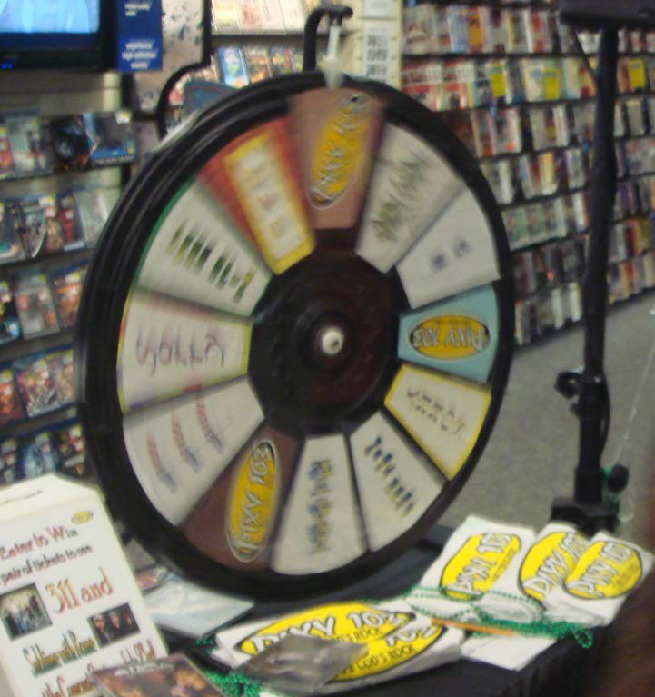
Radio
Use radio to build awareness and serve as a traffic driver when consumers are on the road
6/4 – 8/22
    100 GRPs/week (on top of co-op radio plan)
Cost: $21,675
WPXC-FM/WFRQ-FM will be on-location 2 times at each of the five Cape Cod McDonald’s locations, for a total of 10 appearances
  Each appearance will be a party in itself, with tricycle races, Money machine, Prize Wheel and music.

Slide 5

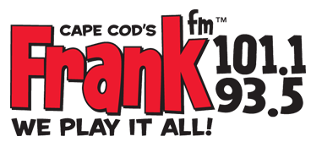

Radio (cont.)
    20x per week :15 promotional announcements
    20x per week :30 promotional announcements
        Each promotional announcement will include a McDonald’s product message
    Over the course of the summer, WPXC will run an on-air spur of the moment scavenger hunt for tickets
  Concert tickets will be hidden randomly at a Cape Cod McDonald’s and an announcements will be made on-air with clues as to where the tickets are hidden

Slide 6
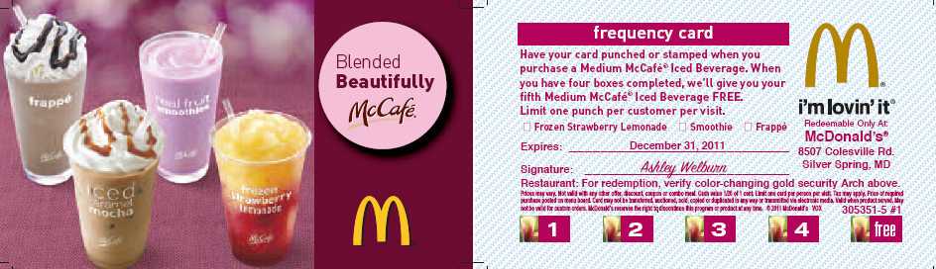
BOG Cards
BOG loyalty cards to be given out at radio events
Quantity: 7,000
Cost: $315 (includes shipping)

Slide 7
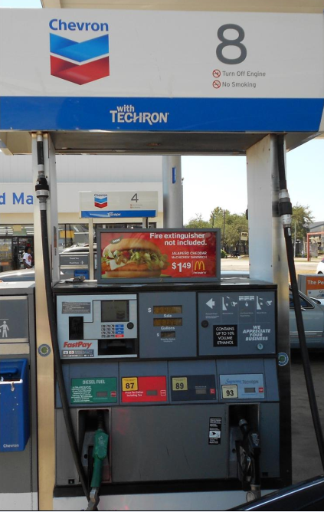
Outdoor
Use gas station toppers as an alternative out-of-home vehicle to drive awareness of McDonald’s $1 Any Size soft drink as consumers are traveling throughout the Cape this summer
9 stations, 36 faces
Timing: 7/25 – 9/20
Cost: $7,146
  Includes production

